Slide 1
CAPSTONE PROJECT 5
DL + ML Project
Face Emotion Recognition
Team Members
Anas Mustafa
Chetan Rajput
Sarthak Rastogi

Slide 2

Content
Problem Statement
Introduction
Data Summary
Approach
Exploratory Data Analysis
Data Augmentation
Convolutional Neural Networks
Model Architecture
Model Performance and Evaluation
Real Time Emotion Detection
Web App and Deployment
Conclusion

Slide 3

Problem Statement
Key Point:
One of the many challenges in web based learning is how to ensure quality learning for students. Digital platforms might overpower physical classrooms in terms of content quality but when it comes to understanding whether students are able to grasp the content in a live class scenario is yet an open-end challenge.
Unable to identify students who need
special attention.
Lack of attention.
Lack of surveillance.

Slide 4

Introduction
What is FER?
Facial Emotion Recognition (FER) is the technology that analyses facial expressions from both static images and videos in order to reveal information on one's emotional state.

Slide 5
Data Summary
FER2013 (Facial Expression Recognition 2013) Dataset
The data consists of 35887 grayscale images of faces at a resolution of 48x48 pixels. The faces have been automatically registered such that they are more or less centred in each image and take up around the same amount of area.
It has seven categories based on the emotion expressed in the facial expression (0=Angry, 1=Disgust, 2=Fear, 3=Happy, 4=Sad, 5=Surprise, 6=Neutral). There are 28,709 examples in the training set and 3,589 examples in the public and private test sets.

Slide 6
Approach Overview
Exploratory Data Analysis
Data Preprocessing
Image Data Augmentation
Model Training
Model Performance and Evaluation
Model Deployment

Slide 7
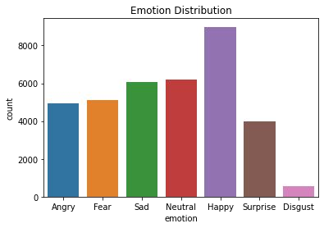
Exploratory Data Analysis
0 | Angry | 4953
1 | Disgust | 547
2 | Fear | 5121
3 | Happy | 8989
4 | Sad | 6077
5 | Surprise | 4002
6 | Neutral | 6198
We have highest numbers of images for happy emotion followed by neutral & sad.

Slide 8
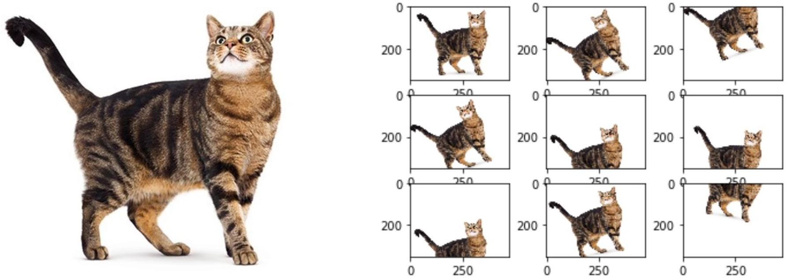
Data Augmentation
Image augmentation is a method of altering original images by applying various transformations to them, resulting in many altered copies of the same image. Depending on the augmentation techniques used, such as shifting, rotating, flipping, and so on, each copy is unique in certain ways.

Slide 9
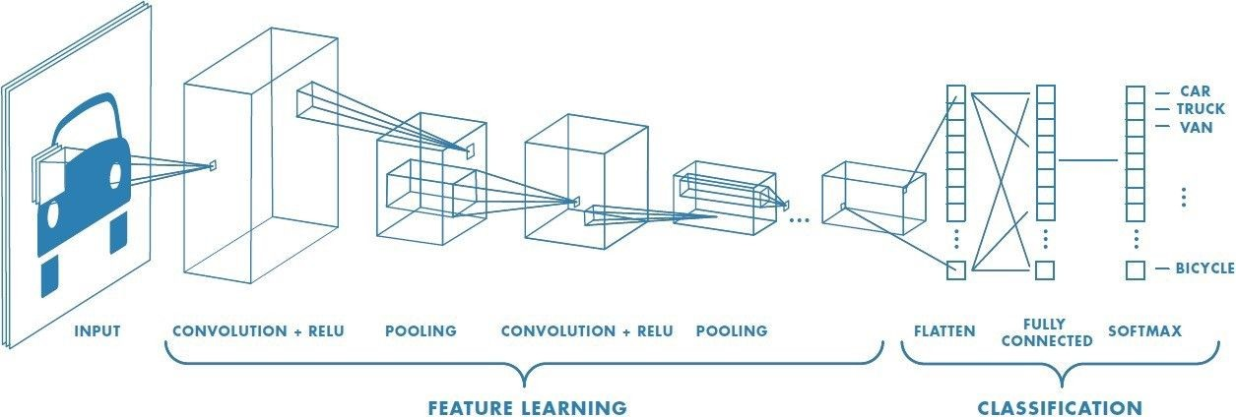
Convolutional Neural Networks
Convolutional neural networks use principles from linear algebra, notably matrix multiplication, to discover patterns inside an image, making them more scalable for image classification and object recognition tasks.
They have three main types of layers, which are:
Convolutional layer
Pooling layer
Fully-connected (FC) layer

Slide 10
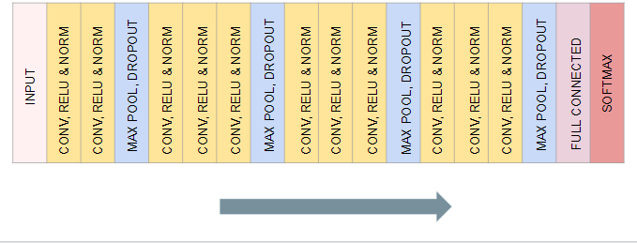
Model Architecture

Slide 11
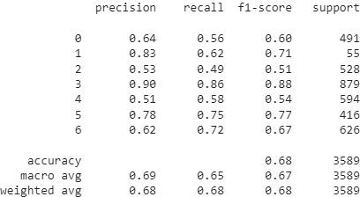
MODEL EVALUTION
Here are the results of the model on test dataset:
It gave an overall accuracy of 0.68 which is close to the results for validation sets, it means the model is working similarly for the unseen data as well.

Slide 12

Real Time Emotion Detection
With the help of OpenCV-Python, a
real time emotion detection was
conducted locally.
Next a web app was created using
Streamlit framework for the same.

Slide 13
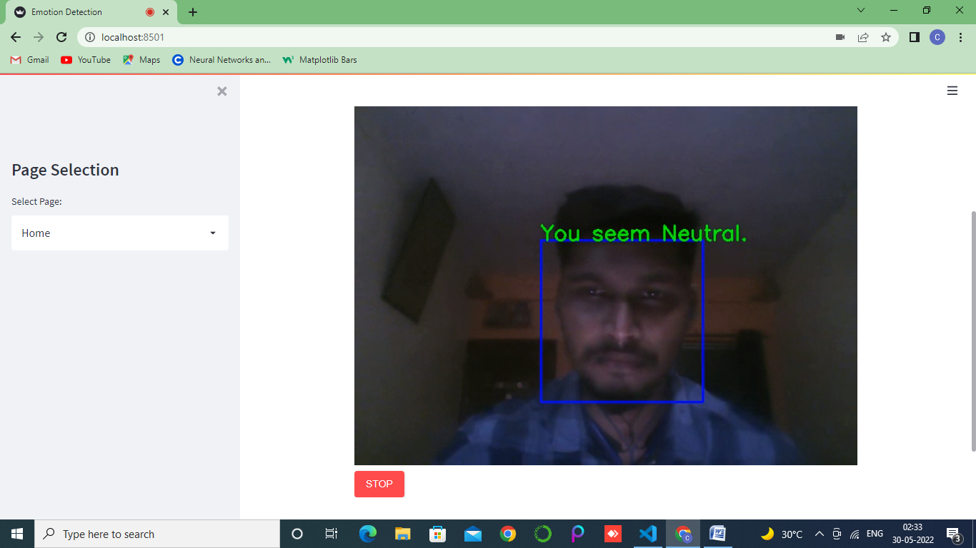
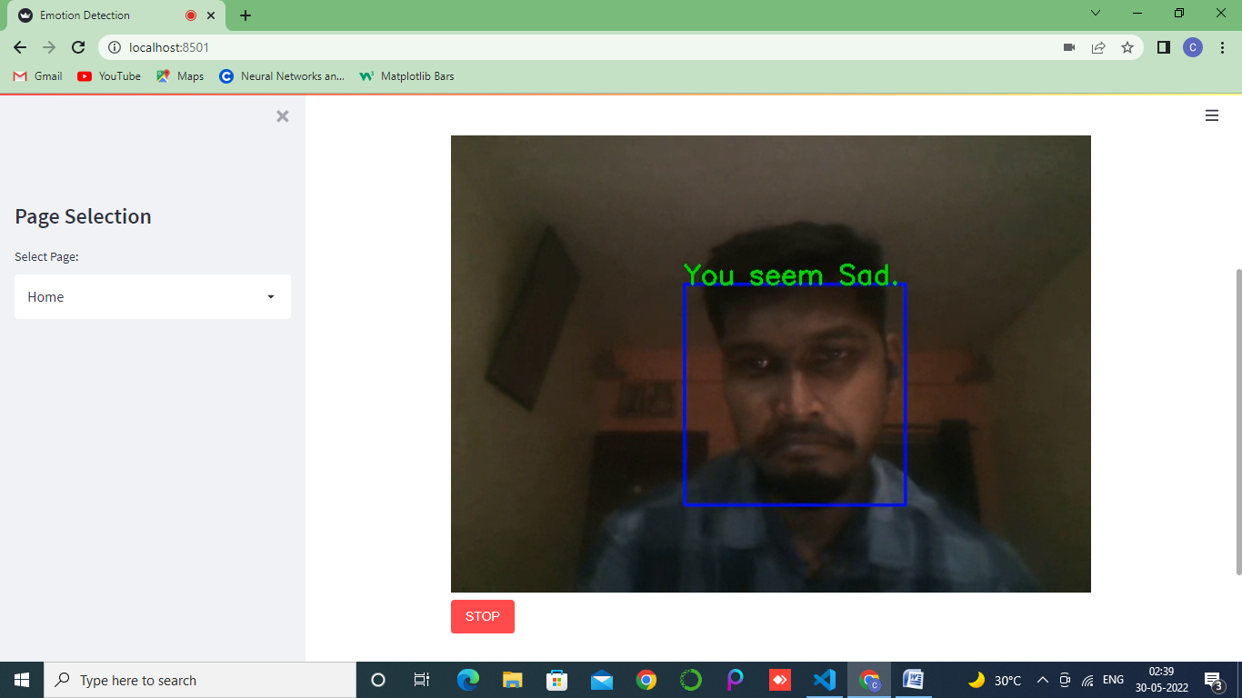
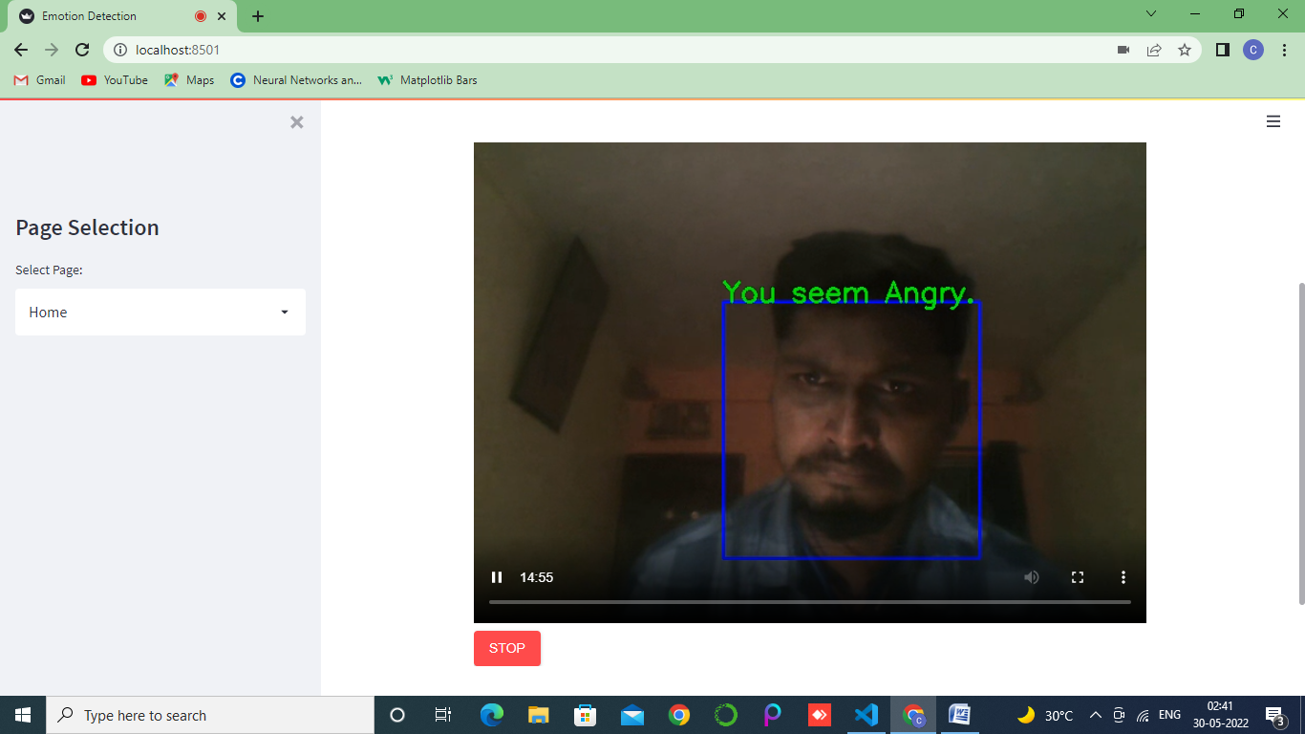
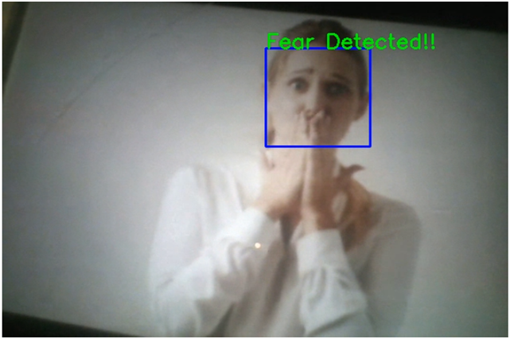


Slide 14
Web App and Deployment
Heroku
Challenges:
Heroku provides free services to deploy models on it’s cloud platform but reducing the size of the slug generated by all the dependencies and model itself was a challenge. Since the slug size is large than soft limit provided by Heroku which is 300 MB, the booting time is really slow.
AWS EC2 Instance
Amazon Web Services is not a free platform but provides free tier services for twelve months, the model was deployed on a Ubuntu virtual machine instance. The computing is really fast.

Slide 15
Conclusion
Face Emotion Recognition is a crucial application of deep learning algorithms which can
be extended to every industry.
Future work in relation to this project can include tracking and analyzing the emotions of
the students. For example If a student is continuously predicted to be sad for a class of an
hour, he/she could be flagged and a report of all the students could be generated at the
end of the lecture for better analysis and further customized lesson plans.
Another important point to conclude is CNN models could achieve extraordinary results
if appropriate and good amount of training data is provided. For example for this
particular case, the training data should include images of students while studying.
The model gave 71% accuracy for training data and 66% for validation data. On the other
hand it gave 68% accuracy for the test.

Slide 16
References
Analytics Vidhya
GeeksforGeeks
Towards Data Science
Built in Data Science
Analytics India Magazine

Slide 17
T H A N K YOU!!

